Slide 1


Emedlife Insurance Broking Services Ltd

Slide 2
Agenda
  Group Health Insurance
  TPA Service Offerings
  Login Procedure
  Process for Hospitalization
  Escalation Matrix

Slide 3
Group Health Insurance
Broker
Emedlife Insurance Broking Services Limited
Insurer
National Insurance Company Limited
TPA
Family Health Plan Limited

Slide 4
Group Health Plan Employee
Policy Holder Tavant Technologies India Pvt. Ltd
Period of the Cover 12 months
Inception Date 7th Oct 2016 {Date of Joining for New Employees}.
Expiry Date 6th Oct 2017 {Date of Leaving for Employees Quitting Tavant Tech}
Insurer National Insurance Company Limited
TPA Family Health Plan Limited
Sum Insured Limits INR 5 Lakhs per family.
Members Covered Maximum 4 members per family. Employee , spouse (1), children (2 up to 21 years) & Parents (2) Policy with an age cap of 80 years. Mid-term changes in nominations are not permitted.
No Individual should be covered as a dependent of more than one employee .
Geographical Limits India (Covers treatment in India only)
Mid-Term Enrollment : Newly married employees’ spouse where the marriage has occurred within the policy year & new born children during the policy year. These members will be covered from the date of such an event (within 30 days from date of marriage or date of birth of new born) provided that the data has been communicated on occurrence to the insurer through HR.

Slide 5
Group Health Plan Parents
Policy Holder Tavant Technologies India Pvt. Ltd
Period of the Cover 12 months
Inception Date 7th Oct 2016 {Date of Joining for New Employees}.
Expiry Date 6th Oct 2017 {Date of Leaving for Employees Quitting Tavant Tech}
Insurer National Insurance Company Limited
TPA Family Health Plan Limited
Sum Insured Limits INR 3 Lakhs per family.
Members Covered Maximum 2 Parents (2) Policy with an age cap of 80 years. Mid-term changes in nominations are not permitted.
Geographical Limits India (Covers treatment in India only)

Slide 6
Group Medi claim Coverages Employee
Family floater policy for Employees with Sum Insured of Rs. 5 Lacs per family.
Family Size : 1+3(Self + Spouse, 2 dependent children )
Pre-existing Diseases.
Waiver of Time exclusion for diseases (30 days / 1,2 & 4 year).
Maternity Benefit of INR. 50,000/- for Normal and INR. 75,000/- C-Section (Pre/Post Natal not applicable ).
Waiver of 9 month waiting for maternity benefit.
New Born baby cover from Day 1 within the family floater cover.
Room Rent( inclusive of Nursing charges) Single Private A/C maximum upto 1% of Sum Insured for Normal and 2% of Sum Inured for ICU
Ailments restriction : Cataract Rs. 25000 per eye, Hernia – Rs. 30000 , Hysterectomy – Rs. 30000 , Piles – Rs. 30000
Oral Chemotherapy Covered (Only for Pre & Post Hospitalization)
Lasik Surgery Covered if the power is beyond +/- 5
Ambulance charges Rs.1000. Per event based on Emergency requirement
Cashless is available only in Hospitals empanelled with FHPL (TPA) & Preferred Policy Network (GIPSA) in Eight locations as mentioned below.
1 > Delhi 5> Chennai
2 > Mumbai 6> Punjab
3> Kolkata 7> Bangalore
4> Hyderabad 8> Ahmedabad

Slide 7
Group Mediclaim Coverages Parents
Family floater policy for Employees with Sum Insured of Rs 3 Lakhs for Parents.
Family Size : 1+1(Father and Mother)
Pre-existing Diseases.
Waiver of Time exclusion for diseases (30 days / 1,2 & 4 year).
Room Rent( inclusive of Nursing charges) Cap of 1% of sum insured & 2% of sum insured for ICU in all hospitals.
Ailments restriction : Cataract Rs. 25000 per eye, Hernia – Rs. 30000 , Hysterectomy – Rs. 30000 , Piles – Rs. 30000
Ambulance charges Rs.1000. Per event based on Emergency requirement
Cashless is available only in Hospitals empanelled with FHPL (TPA) & Preferred Policy Network (GIPSA) in Eight locations as mentioned below.
1 > Delhi 5> Chennai
2 > Mumbai 6> Punjab
3> Kolkata 7> Bangalore
4> Hyderabad 8> Ahmedabad

Slide 8
Scope of Insurance Cover
Includes:
  Only “in-patient” hospitalization expenses.
  Active treatment with minimum 24 hours hospitalization.
  Pre-hospitalization expenses of 30 days before admission and post hospitalization expenses for 60 days after discharge for an eligible hospitalization, Not Applicable for Maternity Claims.
Excludes:
  Non - Medical Expenses - Registration/Admission fees, hospital surcharge, food bills for attendants, telephone charges, pharmacy charges for non-medical items etc.
  Other standard exclusions.

Slide 9
Standard exclusions to the Insurance Cover
Injury or disease directly or indirectly caused by or arising from or attributable to war or war like situations and by nuclear weapons.
Circumcision unless necessary for treatment of diseases
Congenital ailments or defects/anomalies
Hospitalization for convalescence, general debility, intentional self-injury, use of intoxicating drugs/ alcohol.
Venereal diseases, HIV and AIDS, Infertility treatment and Naturopathy
Cost of spectacles, contact lenses, hearing aids
Any cosmetic or plastic surgery except for correction of injury
Hospitalization for diagnostic tests only even if prescribed by a medical practitioner
Voluntary termination of pregnancy during first 12 weeks (MTP)
Unproven or experimental treatment not approved by Indian Medical Council

Slide 10
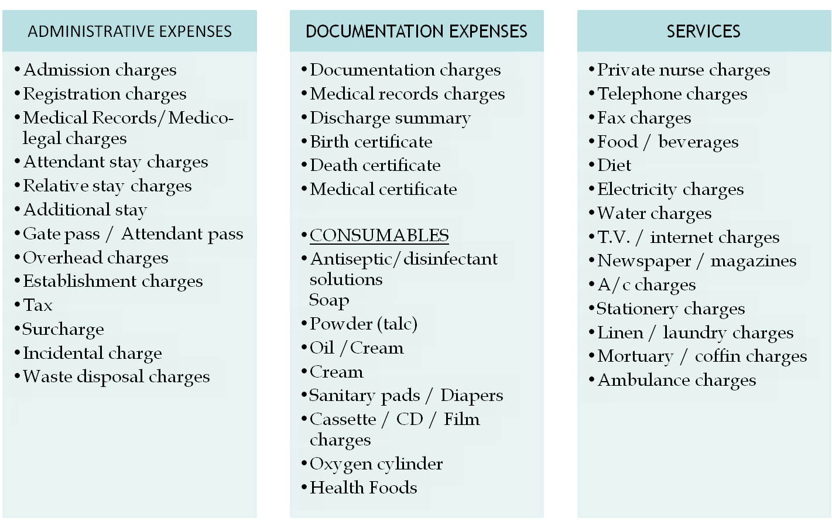
Exclusion - Non Medical Expenses

Slide 11
Family Health Plan TPA Limited – Service Offerings
  Online access to view dependants details ,claim status and e –cards.
  Cashless Hospitalization
  SMS facilities for Pre-authorizations.
  24 hour telephonic Nurseline.
  Claims Administration.

Slide 12
Procedure for Online access
Please follow the below steps to Login
URL: https://www.fhpl.net/FhplLogins/Ecard/Login.aspx?Type=ecard
Corporate ID : 482
User ID: Employee ID # (Example: H0022)
Password: First letter of your name and last 3 digits of employee ID (Ex : Emp name : Chethan Raj, Emp ID : H0022 – password : C022).

Slide 13
How does the plan work ?
Hospitalization event can be:
Planned or Emergency
In a Network hospital or Out of Network

Slide 14




Network Hospitalization (Planned)
Call up Nurseline (18004254033)
48hrs prior to Admission date
Nurseline Sends Pre-Auth (Available on www.fhpl.net)
Fill it up by the help of the treating Doctor and fax it back to the Nurseline
Medical Management Team assesses the Pre-auth and after it is approved, Nurseline sends Credit letter to Network Hospital
All Medical Expenses including Room Rent would be covered

Slide 15

Network Hospitalization (Emergency)
Call up Nurseline if possible
Or else, get hospitalized into the nearest Network Hospital with the E- card
Get the Patient treated and after the patient has Stabilized, complete the Pre-auth process
You can also identify yourself as a member of TPA so that they can assist you with the Pre-auth formality.

Slide 16

Non-Network Hospitalization (Planned & Emergency)
Claim Intimation has to be provided to HR/Emedlife/TPA
Kindly make the arrangements for the admission and pay for all expenses at the hospital
Claim needs to be sent to us within 20days from the Date of Discharge
Collect all original documents from the Hospital including the Hosp. & Dr. Reg No.
Pre & Post Hospitalization Bills
Pre Bills: 30 days prior to Date of Admission
Post Bills: 60 days after Date of Discharge

Slide 17
Procedure of discharge & claim at Non - Network Hospital
The employee is requested to arrange for the admission and all other payments required by the hospital.
Collect and submit the following documents (in original) after discharge
    Signed Claim Form
    Discharge Card.
    Main Hospital Bill (with proper split up, ie. Itemized).
    Prescriptions, reports and bills for all investigations done.
    Prescriptions and bills for medicines consumed during hospitalization.
    Break-up of the medicines bills amount to Rs.200/- or more.
    Hospital’s registration number is required and Mandatory
    ID Proof of the patient
    Copy of cancelled cheque
NOTE: A claim will not be assessed if the documents mentioned in red are not submitted.
Claim Submission Timeline - All claims to be submitted to TPA within 21 days from date of discharge. In case of post hospitalization, the timeline would be 30 days from - treatment completion or completion of 60 days post hospitalization, whichever is earlier.
NOTE : Any delayed submission beyond the timeline mentioned above will not be processed. In such cases, letter from the employee would be required with a valid reason for delay in submission. It is at the discretion of the Insurer to provide the approval for such cases.

Slide 18
Claims Administration
Claims Administration Team
  Document handling
  Registration of claim with insurer
  Liaison with insurer for payment
  Explanation of paid amounts and rejection
Document Recovery Team (DR Team)
  Sends reminders for the missing/required document(s). In case of non-receipt of the same, may send the entire claim back to the employee or deduct the appropriate amount and send the balance claim for QC
Quality Check Team (QC Team)
  Re-assesses the claim to ensure that the claim is complete in all respect before sending it for payment to the insurance company.
Claim settlement
  Approximate time to settle claim is 15 working days from completion of documentation

Slide 19
Possibility of Denial of Cashless - examples
Admission for investigations/ observation / evaluation only.
Treatment not matching with disease mentioned on pre - authorisation form.
Any treatment which otherwise could have been taken on OPD basis.
Any congenital external disease.
Hospital not sending proper query reply raised by TPA on time.
Active line of treatment not mentioned in the pre-auth form

Slide 20
For any kind of clarification, please get in touch with E-medlife SPOC:
 | Emedlife | FHPL TPA
Account Manager | Mr. Srinag U | Mr. Shravan Kumar
Phone no | +91 9008 283565 | +91 98443 76706
Mail ID | Srinag_u@emedlife.co.in | shravan.kumar@fhpl.net
Escalation | Mr. Arjun Koneti | Mr. Ramalinga Reddy
Phone no | +91 9008 144 456 | +91 9243 479 822
Mail ID | arjun_k@emedlife.co.in | ramalinga@fhpl.net

Slide 21
We are assuring the best services at all time.
Than You.

